Slide 1
Course Overview

Slide 2
What You Will Learn
Values & Principles
Concepts
Best Practices
Technologies
Formulas
Tools
Resources
Notes:
Copy paste is a thing

Slide 3
Curriculum - 3 Modules
M1 - WebDev 101
M2 - Backend
M3 - SPA + REST
HTML
CSS
Javascript
DOM
OOP
Canvas
ES6
HTTP
Node.js
Express
MongoDB
jsx
React
REST APIs

Slide 4
How You Learn
Rituals
Lessons
Practice
Review
Resources
Projects

Slide 5
Module Structure
Foundation
Adaptive
Lessons
Lessons
Practice
Practice
Implementation
Review
Project

Slide 6
Flow - Intensity
M1 - WebDev 101
M2 - Backend
M3 - SPA + REST
W1 Foundation
W2 Adaptive
W3
Project
W4 Foundation
W5 Adaptive
W6 Project
W7 Foundation
W8 Adaptive
W9 Project
Hackshow

Slide 7
Rituals
Class Master
Calendar
Stand-up
Daily kick-off

Slide 8
Class Master
One TA per week
What is?
Maintain calendar
Run schedule
Reminders
Fix blockers
Producer
Facilitator
Servant leader
“Scrum” Master

Slide 9
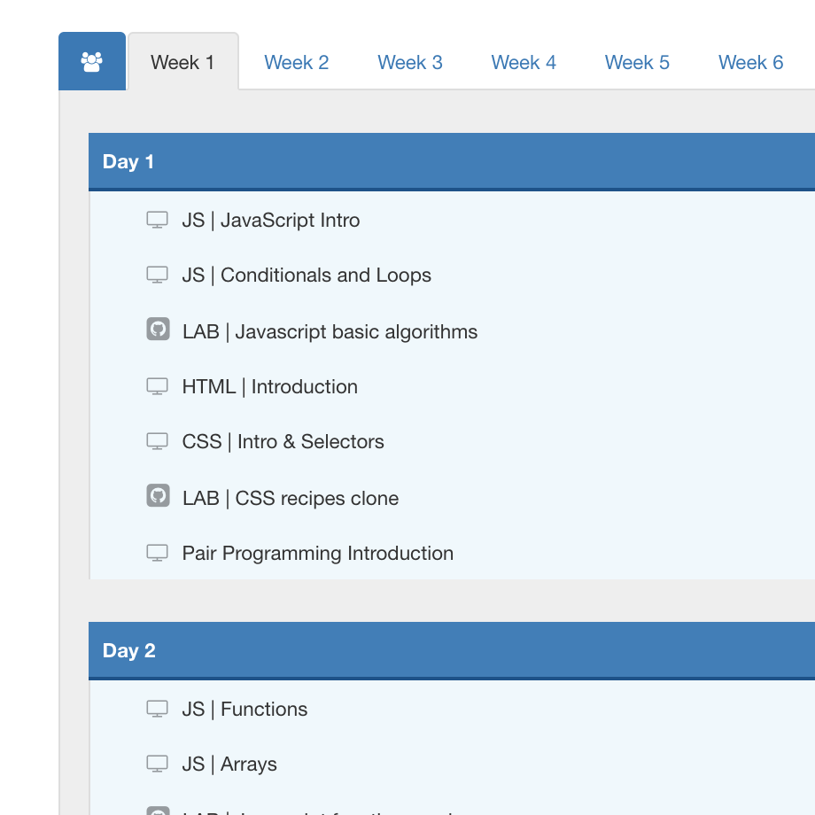
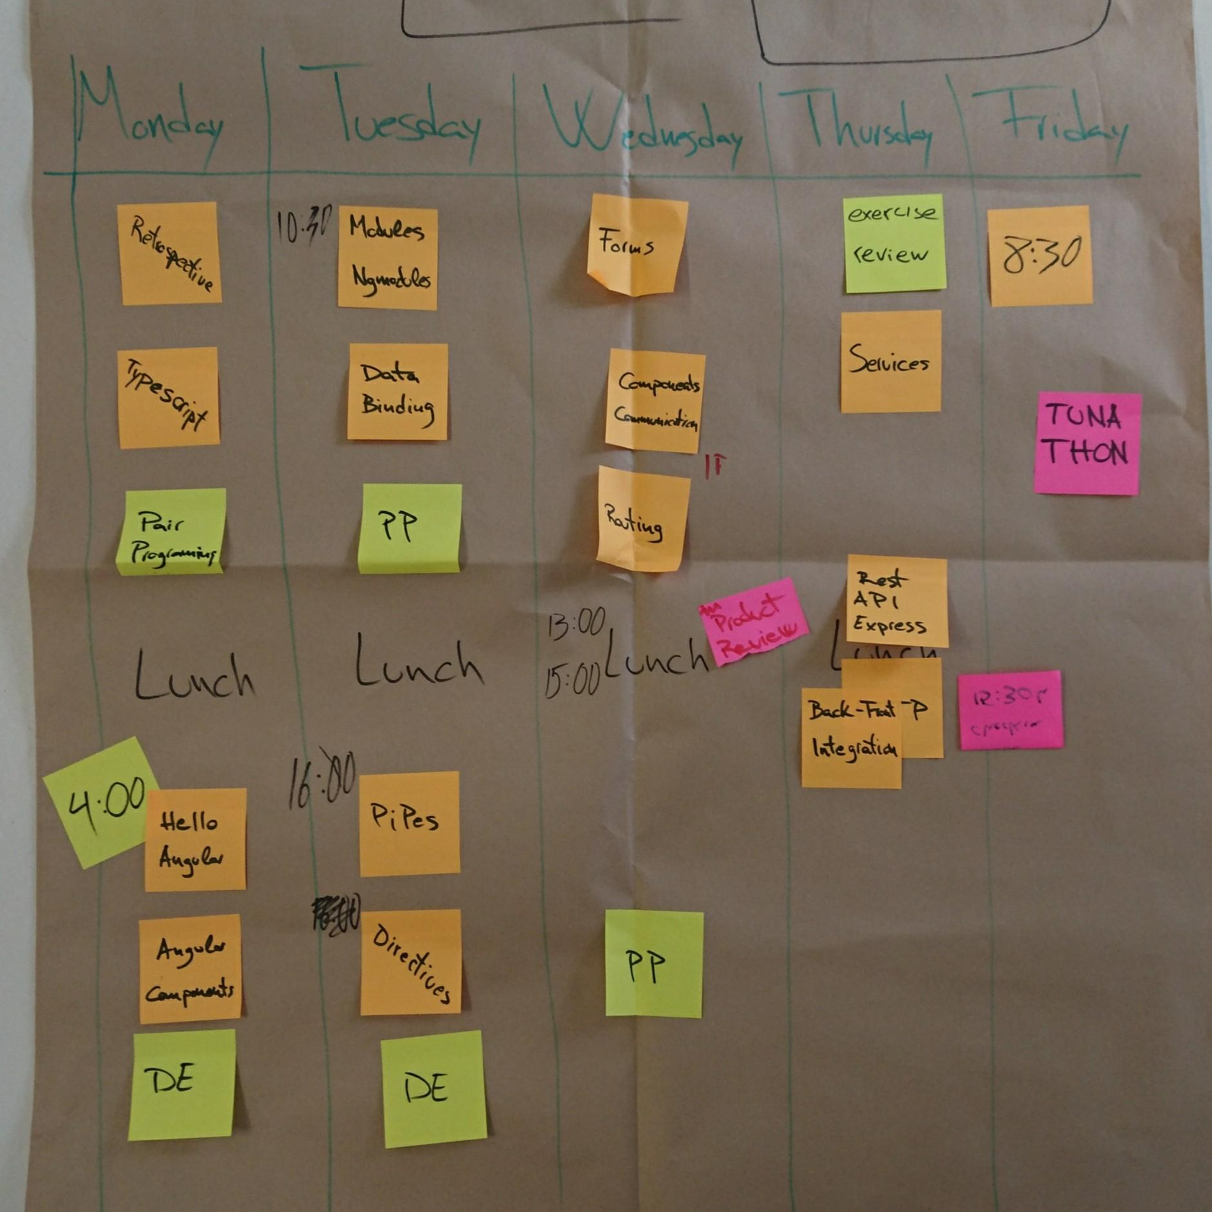
Calendar

Slide 10
Stand-up (~15’)
Everyday practice
Everyone speaks
9 AM
Standing up
10-15min mins
Practicing and improving everyday
How are you feeling?
What did you achieve yesterday?
PR?
What do you expect from today?
Is there something blocking you?

Slide 11
Daily Kick-off (~10’)
+ Adaptive
Review agenda/options for the day
exercise reviews
learning objectives
scope of practice sessions
activities with a purpose
decide together on lessons, practice and reviews
Make changes to calendar
Agree
Recap & Go

Slide 12
Lessons
+ Adaptive Lessons
Lectures
Activities
Quick Demos
Code Alongs

Slide 13
Lectures (1h ~ 2h)
Lecturing is hard for everyone
Students should:
stay focused and on topic OR quiet
not be on laptops if no laptop needed
ask questions
questions not answered? take notes for later
ask to switch to code/browser and fix zoom
ask for a break if they need

Slide 14
Activities (15’ ~ 30’)
Learning is rewarding for everyone
role play
diagramming
mobbing
Students should:
be open to go out of their comfort zone

Slide 15
Quick Demos (~30’)
Teachers code, students watch
Introduction to concepts and technologies
Students should:
not code, just focus
ask questions
take notes for later

Slide 16
Code Alongs (2h ~ 4h)
Teachers code, students follow
Broken into steps
Students should:
understand the purpose of each step
ask questions related to the step
take note of other questions for later
once you’re done, help other
Focus and silence, no conversation
Answer clearly to “CAN WE CONTINUE” and “WHO IS BLOCKED”

Slide 17
Adaptive Lessons (1h ~ 2h)
+ Adaptive
All class OR smaller groups
redo a concept or topic
deep dive into a concept or topic
advanced concepts and topics
Students should:
ask for it
decide when/what/who

Slide 18
Practice
Pair Programming
Daily Exercise

Slide 19
Pair Programming (1h ~ 3h)
Students working together on same activity, in groups of 2 or 3
1 codes (driver), the other(s) dictates (navigator)
Students should:
decide role in activity
use 1 laptop
communicate
switch roles after 30’ or 45’
Steps:
fork + clone
commit + push
create pull request
BCN - name + name
tag your pairs @name
add comments (questions/blockers)

Slide 20
Daily Exercise (1h ~ 3h)
Helps consolidating knowledge
Go a step further than what we talked in class
Students should:
finish the exercise
submit before stand-up
Steps:
fork + clone
commit + push
create pull request
BCN - name + name e.g. BCN-Anna-Ben
tag your pairs @name
add comments (questions/blockers)

Slide 21
Review
(Daily) Exercise Review

Slide 22
(Daily) Exercise Review (~30’)
Class decides if/when to do it
Not a review of an entire exercise
No official solution
review and comment one or more PR
student explain their code and are guided to solution by TA or LT
Students should:
ask questions (prepare for it)
share their ideas
share their solutions

Slide 23
Adaptative sessions (1h)
+ Adaptive
All class OR smaller groups
on-demand Q&A sessions
review PRs of exercise
review concepts
Students should:
ask for it
decide when/what/who
prepare for it (scope, questions, blockers)

Slide 24
Projects
Projects
Retrospectives

Slide 25
Projects (6d ~ 8d)
Kick-off (1d ~ 2d)
Execute (4d ~ 5d)
Deliver (1d)
Idea & Validation
Planning & Sign-off
NOTE: until all projects are signed-off, reviews and advanced classes are still be in progress
Stand-up
Kata
Code / Test / Refactor / Deploy
Presentation
Demo
Replan
Code freeze
Presentations

Slide 26
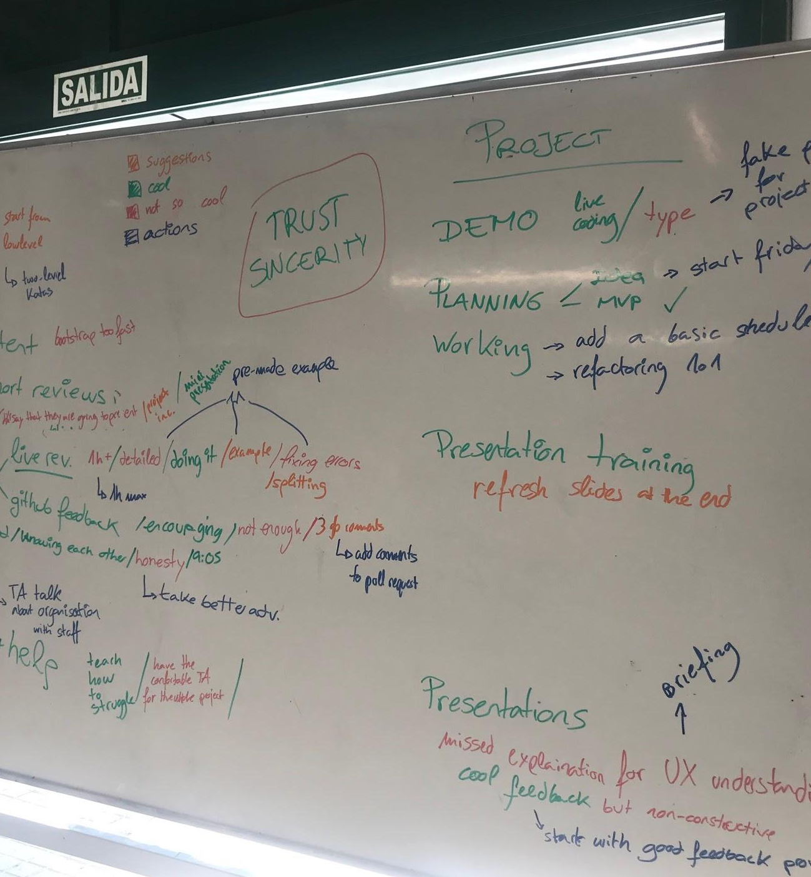
Retrospectives (1h)
Reflect on how the team is working together
What is working well and what to improve
Generate insights
Take actions
Improve your experience
Improve the next module
Improve the bootcamp

Slide 27
Collaborations
UX/UI - WebDev feedback
Hackathon

Slide 28
UX/UI feedback (~30’)
M3 WebDev projects
UX/UI coding week
UX/UI students feedback
Wireframes
UI
WebDev feedback
Personal portfolio
HTML, CSS, Javascript

Slide 29
Hackathon (1d)
One day challenge
UX/UI - WebDev Teams
Experience
Project from start to end
Real world experience
2-3 UX/UI - 2-3 WebDev
Work under pressure
Collaboration
Communication
Learn from each other

Slide 30
Resources
> Class Guidelines
> Module 1 Guide
> Module 2 Guide
> Module 3 Guide
> Materials
> Cheat-sheet > Mantras
>TA Article

